Slide 1
FY24 Tewksbury Public Schools Finance Committee Presentation
T
March 13, 2023

Slide 2
FY24 School Department Budget
District Strategy
The Tewksbury Public Schools community believes that our educational program will encompass current, research-based teaching, learning, and an assessment approach that promotes consistent growth among our students and staff to achieve academic, social, and emotional success for all students.

Slide 3
FY24 School Department Budget
Theory of Action
If Tewksbury Public Schools prioritizes a sense of belonging and growth mindset amongst all stakeholders while providing quality professional development and a professional culture grounded in collaboration, then all students will experience innovative, equitable, and student-centered instruction prioritizing positive outcomes.

Slide 4
FY24 School Department Budget
Challenges Faced In Formulating FY24 Budget
Typical | FY24
Traditionally 7-school model | NEW 6-school model. Center Elementary School opened January 2023. Relocation of all Grade 2, 3 & 4 students and associated personnel mid-year. Re-allocation of resources associated with this move to create a Salary and Operating budget for the new school.
Use prior years ACTUALS to determine needs and/or budget opportunities | Only have 6 months of data with new building structure. Schools still feeling effects of COVID 19 and students recovering from learning loss.
Use of ESSER grants ends FY24 | Need to balance the use of ESSER funding by the deadline with ability to support needs (if they are recurring) within the budget in the future
Pre-School Re-Structure | With additional space available at PK-1 schools, able to balance Pre-School offerings between Dewing and Heath Brook to offer Pre-School at BOTH locations

Slide 5
FY24 School Department Budget
Areas of FOCUS
Personnel
NEW CENTER ELEMENTARY!!!
Assess personnel moved from other K-4 schools for most efficient use
Increase PK programming
Assessing personnel needs based on currently declining enrollment
Assess grant funded personnel and begin to fund via LEA budget, if appropriate
Operational
NEW CENTER ELEMENTARY!!!
Estimate effects on transportation, utilities, supplies, insurance, maintenance
Funding New ELA Curriculum
Technology
Communications
Improve systems
Continue Smartboard to Cleartouch conversion districtwide
Wiring (E-Rate discount)
Printing solutions (copy center)
Building Improvements
Needs of HB & DEW
To get through 6-10 years
Building & Grounds Systems
HVAC, Electric, Plumbing, Security, Landscape

Slide 6
FY24 School Department Budget
3.07% increase Requested

Slide 7
FY24 School Department Budget
If including Fixed Costs & Debt 2.7% increase Requested

Slide 8
FY24 School Department Budget
SALARY – 70.7% of School Budget

Slide 9
FY24 School Department Budget
OPERATING – 27.8% of School Budget

Slide 10
FY24 School Department Budget
CAPITAL OUTLAY – 1.5% of School Budget
PRIORITY
Funding new ELA curriculum materials
ClearTouch Boards for balance of classrooms in District
HVAC assessment for HB & Dewing
Electrical Assessment for HB
Plan for re-landscaping rear of HB grounds

Slide 11
FY24 School Department Budget
BUILDING SYSTEMS: LETTER GRADES
WHERE ARE WE NOW?

Slide 12
Potential Capital Projects
List
FY23-FY25

Slide 13
Capital Projects Completed List FY21-FY23
2020-2021
2021-2022
2022-2023

Slide 14
FY24 School Department Budget
Grants/Revolving Accounts
64 Separate Funds currently ACTIVE
All have a specific purpose and must be used appropriately. Use MUST be related to the purpose of the fund…whether a GRANT or Revolving type account driven by fees.
Approximately 35 positions funded (partially/fully)

Slide 15
FY24 School Department Budget
Grant Funding Available FY23*
Code | Grant | FY | Purpose | Grant Total | Amount Used* | Encumbered* | Balance
115 | ESSER II | 2022 | COVID Related Expenses | $ 1,198,356 | $ 1,024,320 | $ 167,767 | $6,269
119 | ESSER III | 2022 | COVID Related Expenses | $ 2,773,695 | $ 89,833 | $ 108,039 | $2,575,823
140 | Title IIA | 2022 | Educator Improvement | $ 65,874 | $ 36,706 | $ 14,665 | $14,503
180 | Title III | 2022 | Support for English Learners | $ 11,748 | $ 545 | $ - | $11,203
240 | IDEA Special Education | 2022 | Special Education Improvement | $ 868,369 | $ 813,947 | $ 45,531 | $8,891
252 | ARP Special Education | 2022 | Special Education Improvement | $ 176,839 | $ 92,746 | $ 9,750 | $74,343
262 | Early Childhood IDEA | 2022 | Pre School Special Education Quality | $ 32,632 | $ 9,988 | $ 13,871 | $8,773
264 | ARP Early Childhood | 2022 | Pre School Special Education Quality | $ 16,477 | $ 16,080 | $ 397 | $ -
305 | Title I | 2022 | Student Support | $ 190,081 | $ 167,669 | $ 518 | $21,894
309 | Title IV | 2022 | Academic Support - Recovery/After School | $ 25,544 | $ 18,170 | $ - | $7,374
121 | SAAG | 2023 | Summer Acceleration Academy | $ 87,000 | $ 87,000 |  | $ -
140 | Title IIA | 2023 | Educator Improvement | $ 71,116 |  |  | $ 71,116
151 | SEL | 2023 | Student Support | $ 10,000 | $ 294 |  | $ 9,706
180 | Title III | 2023 | Support for English Learners | $ 20,396 |  |  | $ 20,396
240 | IDEA Special Education | 2023 | Special Education Improvement | $ 887,807 | $ 422,904 | $ 382,571 | $ 82,332
244 | 21stC SPED_YALD | 2023 | Enhanced Programs for Students on IEPs | $ 10,000 | $ 3,655 | $ - | $ 6,345
262 | Early Childhood IDEA | 2023 | Pre School Special Education Quality | $ 26,662 | $ 4,209 | $ 12,806 | $ 9,647
305 | Title I | 2023 | Student Support | $ 383,275 | $ 131,801 | $ 134,528 | $ 116,946
309 | Title IV | 2023 | Academic Support | $ 13,601 | $ 25 |  | $ 13,576
419 | Innovation Pathways | 2023 | Student Enhancement | $ 50,000 | $ 19 |  | $ 49,981
528 | ASOST - School Year | 2023 | After School & Out of School Time | $ 50,000 | $ 475 | $ - | $ 49,525
530 | ASOST - Summer | 2023 | After School & Out of School Time | $ 45,000 | $ 45,000 | $ - | $ -
644 | 21st CCLC - Summer | 2023 | Enrich Academic Programming | $ 55,000 | $ 55,000 | $ - | $ -
645 | 21st CCLC | 2023 | Enrich Academic Programming | $ 148,750 | $ 52,090 | $ - | $ 96,660
 | *AS OF 3/2/23
RED TEXT=ENTITLEMENT GRANTS; TPS RECEIVES ANNUALLY |  |  |  |  |  | TOTAL | $3,255,303

Slide 16
FY24 School Department Budget

Slide 17
FY24 School Department Budget Hearing
NEXT STEPS
Continued Discussions with Building Principals, Department Leaders, Elected Officials, Town Officials, teachers, parents, students and community members, to refine and react to ever changing needs.
As needs and/or resources change, the School Department will be refining our budget, which represents a snapshot in time of the current needs in the district. Our budget, resources and needs are constantly being updated and analyzed for the best use of available and appropriate resources.
This process will continue from now through May Town Meeting and may (in fact is likely to) produce some movement within our overall budget

Slide 18
FY24 School Department Budget

Slide 19
https://www.tewksbury.k12.ma.us/departments-programs/business-office/

Slide 20
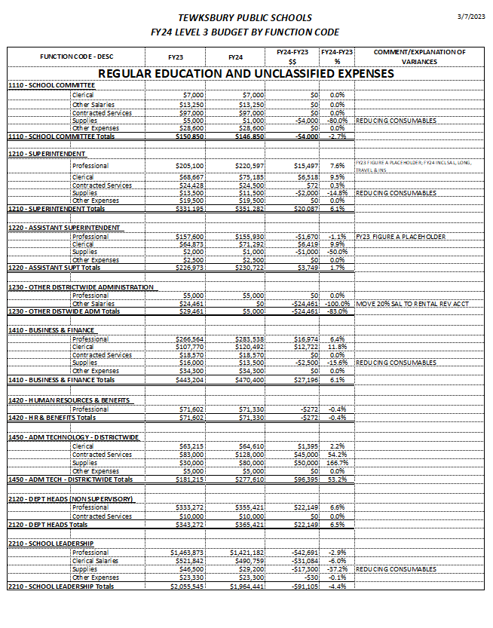
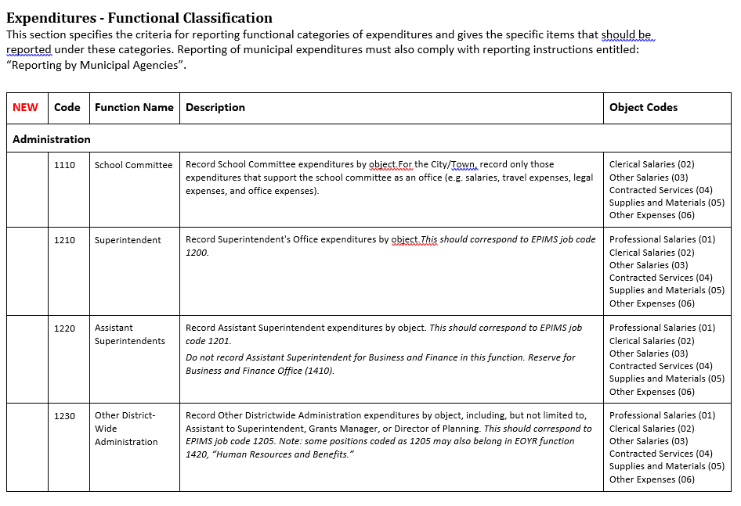
https://www.tewksbury.k12.ma.us/departments-programs/business-office/
State of Mass – Standard Codes for Expenditures

Slide 21
FY24 School Department Budget
Questions or Comments
????

